Slide 1


FULL STACK DEVELOPMENT WITH ASP.NET CORE AND VISUAL STUDIO CODE
Dave Brock
@daveabrock
daveabrock.com

Slide 2


Slide 3


Slide 4




Slide 6


Slide 8

The past: Visual Studio, (generally) our only option

Slide 9
A need for a modern .NET Framework runtime
Released in the early 2000s and a Windows-only and IIS-centric development framework
Over time, this caused a lot of bloat (think of System.Web namespace)
Facilitated a need for a modern, cross-platform environment that is capable of supporting today’s modern applications

Slide 10

Enter .NET Core
Its benefits:
Flexible: Can be included in your app or installed side-by-side.
Cross-platform: Runs on Windows, macOS and Linux and can be ported to other operating systems.
Command-line tools: All product scenarios can be exercised at the command-line.
Performance: Performance outweighs .NET Framework
Modular: You don’t need to “bring the entire framework”
Open source: The .NET Core platform is open source
https://docs.microsoft.com/en-us/dotnet/core/index

Slide 11
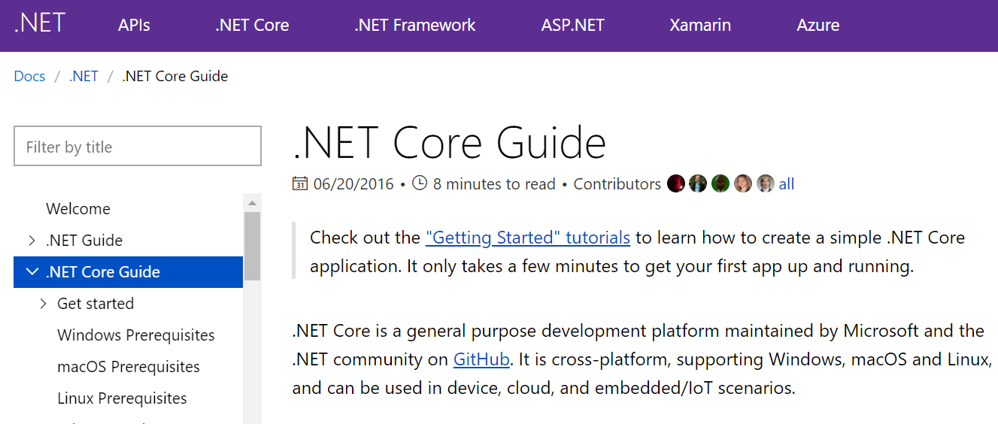
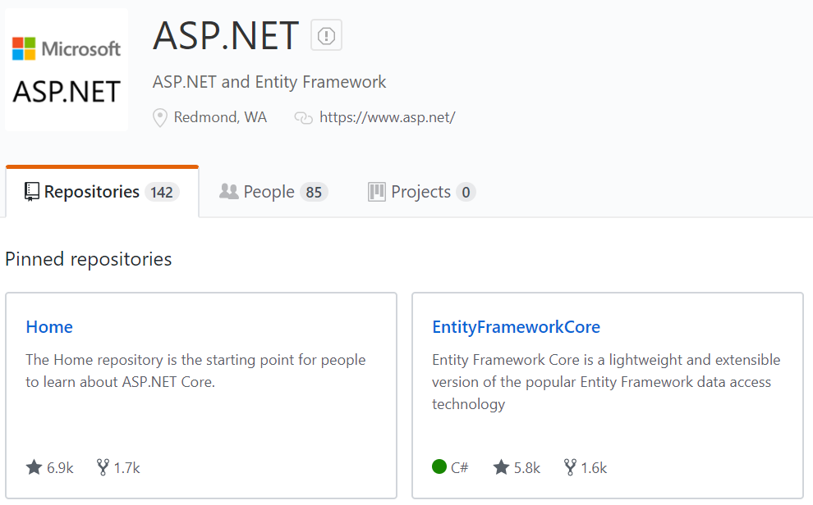
An open-source world

Slide 12
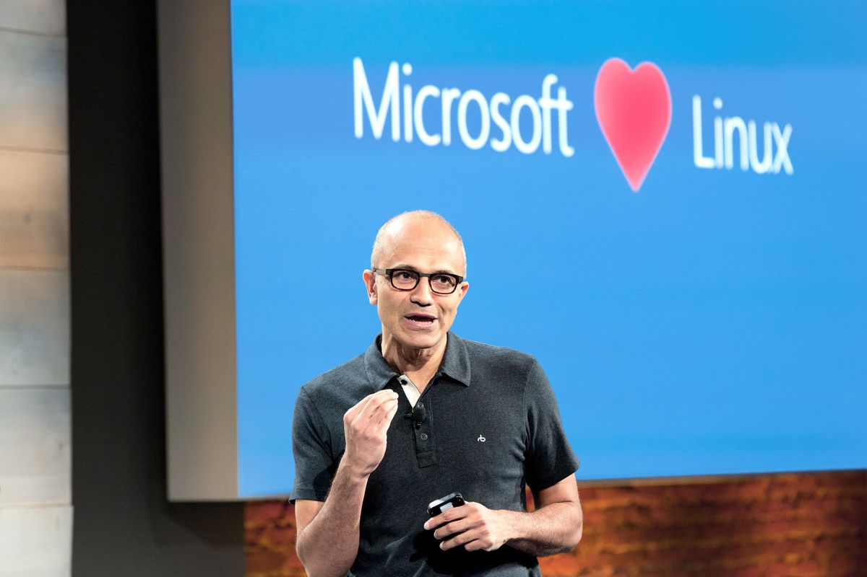

Slide 13


Slide 14
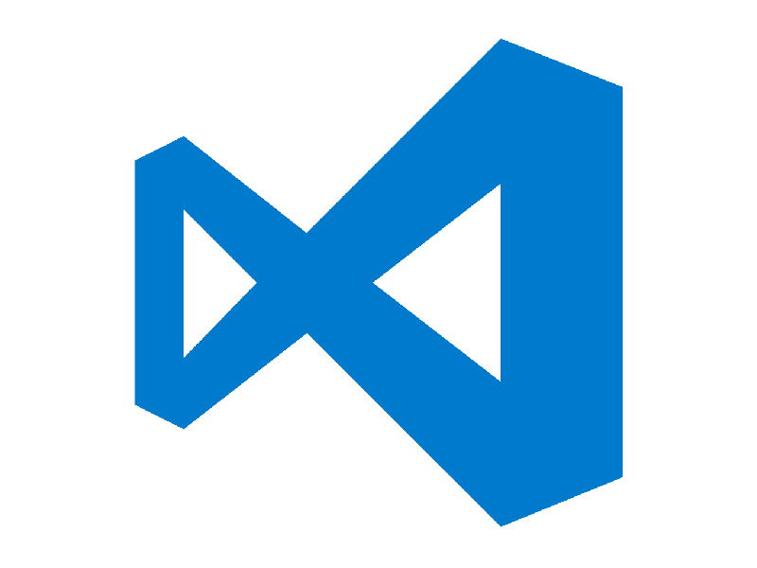
Use the power of a cross-platform framework to use the tools you want

Slide 15
Get to know the .NET Core CLI
dotnet command [arguments] [options]
The cross-platform engine for .NET Core
All .NET Core tooling is built from the CLI
The CLI will have the latest updates and functionality, even before tools like Visual Studio implements them
As with most command-line tooling, you’ll see it is much faster and will make you more productive than relying on the tooling
For a deep dive on the CLI, check out Scott Addie’s “Tour de .NET Core CLI” talk at 12:30pm in P1838

Slide 16
Demo

Slide 17
Resources
.NET Core general documentation
.NET Core SDK download
.NET Core CLI docs
Visual Studio Code download link
Off topic!
The Mistakes I Made as a Beginner Programmer

Slide 18



Thank you!
Reach out anytime…
@daveabrock
daveabrock.com
linkedin.com/in/daveabrock
github.com/daveabrock

